Slide 1

Workshop 1

Slide 2
Workshop 1 Basics Of HTML5 and CSS3
Today’s Outline
Page Basics
Text Basics
Text Formatting
Lists
Inserting Images
Website Project

Slide 3
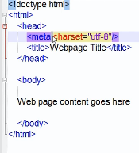
Page Basics
Tag: Simply a instruction to the Brower what to do. And each tag is written with in these brackets“< >”.
Example of Writing a tag
<title> I am Building My First Website </title>
But some tag do not contain any content with in them those are know as void or self closing tag
Example
<meta charset=“utf-8”/>
HTML also provides us way to comment
Example:
<!—This is comment -->
Code Snippet.

Slide 4

Text Basics
H Tag: Used for giving heading h1 to h6
Example <h1> Heading </h1>
P Tag: Used for breaking text into paragraph
Example <p> I am para 1 </p>
br tag: Used for breaking text
Example <br> Text is divided <br/>
strong or b tag: Used to bold text
Example <b> Bolded Text <b/>
em or i tag: Used to Italic text
Example <i> I am italic <i/>
<p> and <br> same

Slide 5
Text Formatting
Section tag: Breaks content into section. You will see no physical change but it help browser to understand that it is broken into section.
Example: <section> I am section </section>
Blockquote tag: Usually use when there is some quotations used. Indents both from both side
Example <blockquote> I am Q1 </blockquote>

Slide 6
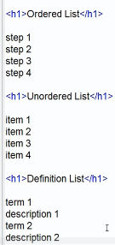
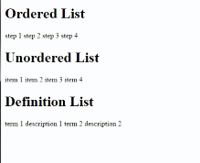
Lists
There types of List
Ordered List: example Series Of Steps
Unordered list: example Shopping List
Definition list: It is a two part list
Example
HTML
Hypertext Markup Language, a standardized system for tagging text files to achieve font, colour, graphic, and hyperlink effects on World Wide Web pages.
Code without applying list tag
Output

Slide 7
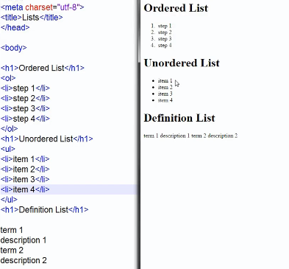

Lists
After Applying tags for ordered and unordered lists
Q1) Can we use ordered list within unordered list
Q2) Can we use a b c instead of 1 2 3 in ordered list

Slide 8
Inserting Images
Inserting Image if very easy in html
Example: <img src=“abcimage.jpg />
This image will show properly but for that our html file and image file must be in same folder and this will not be the case when we will deploy it. Therefore we create a separate folder then give source
Example:<img src=“images/abcimage.jpg”/>
You can set width and height of the image in following manner
Example: <img src=“images/abcimage.jpg” width=“200” height=“213”/>
Figcaption tag can be used for caption of our image
Example: <figcaption> This is abcImage </figcaption>

Slide 9
Lets Begin With Website Project

